Slide 1





Google Android Developer Virtual Intership
by
SUGALI RAHUL
ROLL NO: 224G1A3274
Department of Computer Science and Engineering (Data Science)
Srinivasa Ramanujan Institute of Technology
(Affiliated to JNTUA & Approved by AICTE) (Accredited by NAAC with ‘A’ Grade & Accredited by NBA (EEE, ECE & CSE)
Rotarypuram Village, B K Samudram Mandal, Ananthapuramu – 515701.
2024 - 2025

Slide 2






Contents
Google Andriod Developer virtual Internship
Title of Internship
App Development
Andriod Studio
Introduction Programming
Connecting to the Internet
Performance Optimization
Learning Outcomes
Conclusion
References
Queries
Dept. of Computer Science and Engineering (Data Science)
Srinivasa Ramanujan Institute of Technology
2

Slide 3



What is Android Development?
Google Andriod Developer virtual Internship
Title of Internship
Android development refers to the process of creating applications for devices that run on the Android operating system.
It encompasses a wide range of tools, languages, and frameworks to build functional and user-friendly applications.
Android has a significant market share, making it vital for developers to understand its ecosystem
Dept. of Computer Science and Engineering (Data Science)
Srinivasa Ramanujan Institute of Technology

Slide 4


What is Android Studio?
Google Android Develepor Virtual Internship
Title of Internship
Android Studio is the official integrated development environment (IDE) for Android app development. It is a powerful and highly specialized software tool provided by Google for developers who create applications for the Android operating system. Android Studio offers a comprehensive set of features and tools to streamline the app development process. Here are some key aspects of Android Studio:
Code Editing
User Interface (UI) Design 3.Performance Analysis
4.Version Control Integration 5.Debugger
Dept. of Computer Science and Engineering (Data Science)
Srinivasa Ramanujan Institute of Technology

Slide 5



Introduction to programming to kotlin
Google Android Developer Virtual Internship
Title of Internship
Kotlin, a modern and concise programming language, has emerged as a preferred choice for Android app development. Endorsed by Google, Kotlin offers a seamless integration with existing Java code and brings a host of features like null safety, concise syntax, and improved code readability.
Its expressive and pragmatic nature accelerates development, making it an excellent fit for Android projects. As the official language for Android app development since 2017, Kotlin enhances developer productivity, reduces boilerplate code, and contributes to building robust, efficient, and more maintainable Android applications.
Dept. of Computer Science and Engineering (Data Science)
Srinivasa Ramanujan Institute of Technology

Slide 6

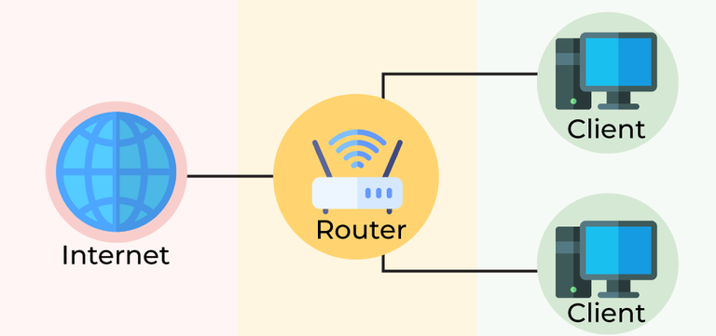
Google Android Developer Virtual Internship
Title of Internship
Connecting to the Internet
In this task, you will add a network layer to use to communicate with the service.
Dept. of Computer Science and Engineering (Data Science)
Srinivasa Ramanujan Institute of Technology

Slide 7


Performance Optimization
Google Android Developer Virtual Internship
Title of Internship
Avoid Overdraw:
Technique: Use the "Show GPU Overdraw" option in Developer Options to visualize and reduce unnecessary UI redraws.
Optimize Layouts:
Technique: Use Constraint Layout to flatten view hierarchies and reduce nested layouts.
Use Recycler View:
Technique: For lists, implement Recycler View instead of List View for better memory management and performance
Dept. of Computer Science and Engineering (Data Science)
Srinivasa Ramanujan Institute of Technology

Slide 8


Outcomes
Google Android Developer Virtual Internship
Title of Internship
By the end of this we will be able to know about:
Gain an overall understanding of basic android.
Become familiar with shared preferences and layouts.
Learn the architectural principles of the android.
Understand and be able to explain android activities building apps.
Engage in hands-on practice to create apps.
Dept. of Computer Science and Engineering (Data Science)
Srinivasa Ramanujan Institute of Technology

Slide 9


Conclusion
.
Google Android Developer Virtual Internship
Title of Internship
Enrolling in Google's Android development course provides a concise yet comprehensive journey into the world of mobile app creation. With Google's expertise in developing the Android platform, learners can expect a focused curriculum covering essential topics like programming languages, the Android SDK, and API integration.
Dept. of Computer Science and Engineering (Data Science)
Srinivasa Ramanujan Institute of Technology

Slide 10


References
Google Android Developer Virtual Internship
Title of Internship
References
https://developer.android.com/courses/android-basics-compose/course
https://internship.aicte-india.org
Dept. of Computer Science and Engineering (Data Science)
Srinivasa Ramanujan Institute of Technology

Slide 11

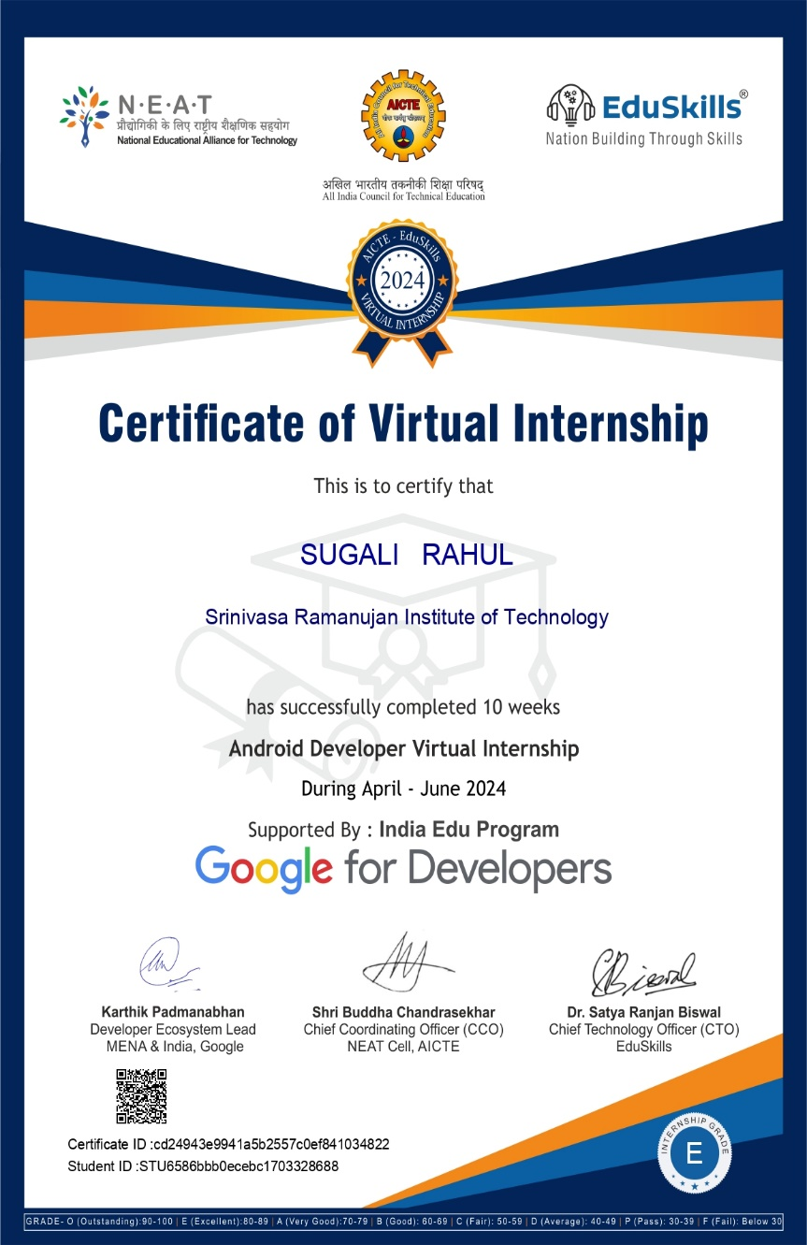
Google Android Developer Virtual Internship
Title of Internship
Internship Certificate
Internship Certificate:
Dept. of Computer Science and Engineering (Data Science)
Srinivasa Ramanujan Institute of Technology

Slide 12



Any Queries?
Google Andriod Developer Virtual Internship
Title of Internship
Dept. of Computer Science and Engineering (Data Science)
Srinivasa Ramanujan Institute of Technology

Slide 13



Thank You!!!
Google Andriod Developer Virtual Internship
Title of Internship
Dept. of Computer Science and Engineering (Data Science)
Srinivasa Ramanujan Institute of Technology

